Slide 1
Population ageing - a demographic trend with multiple consequences!!
Prof. Manuela Epure, PhD

Slide 2
Population ageing – a reality
Population is ageing. The problem becomes a global problem because of the linkages across nations. PA is more pronounced in most higher-income countries and is progressing quickly in some developing countries , notably China.
Why?
People are living longer: Life expectancy in the EU continues to increase rapidly (the share of over 65 years old in the society is rising rapidly)
The fertility rate decreases and its causes slower population
growth.
Many of additional years that people are living are
healthy ones.
Notes:
America's seniors now outnumber the entire population of Canada.
Did you know …that more than 90% of older Americans receive income resources from Social Security? Click on the graph below that shows the distribution of income resources received by elderly.

Slide 3
Dynamics of Population Aging in the Modern World
Observed and Forecasted Percentages of the Elderly (65+ years) I
n Selected Areas, Regions, and Countries of the World:
1950, 2000 and 2050.
Source: United Nations 2001.
Major Area, region and country | 1950 | 2000 | 2050
World | 5.2% | 6.9% | 19.3%
Africa | 3.2% | 3.3% | 6.9%
Latin America & Caribbean | 3.7% | 5.4% | 16.9%
China | 4.5% | 6.9% | 22.7%
India | 3.3% | 5.0% | 14.8%
Japan | 4.9% | 17.2% | 36.4%
Europe | 8.2% | 14.7% | 29.2%
Italy | 8.3% | 18.1% | 35.9%
Germany | 9.7% | 16.4% | 31.0%
Sweden | 10.3% | 17.4% | 30.4%
U.S.A. | 8.3% | 12.3% | 21.1%
Notes:
As you can observe, there are some countries which are already experience a high percentage of people 65+ such as Italy, Japan (over 17%) and the projections for horizon 2050 reveal China ’s case, Japan, Italy and EU.

Slide 4
Effects of population ageing on the economy
Fewer people are working to support more and more people who are not working
Population ageing affect the public finances; it creates a imbalances in national budgets
The society must find solutions to absorb the costs of population ageing.
An adaptation process is required because ageing is a global process.

Slide 5
Topics:
Defining the problem
Four basics approaches to the population ageing
People’s economic behaviour during their life cycle
The Policy makers of today and their legacy to pass on future generations
Further research directions
Notes:
I would like to introduce the following topics, just scratching the “surface of the iceberg”, I may say. The topics listed are not comprehensive, but it should raise debates and maybe further cooperation in order to develop comparative studies at EU 27.

Slide 6
Topic 1 Defining the problem
Population ageing seen as a demographic trend;
- statistics – national & EU level
Graph 1 Graph 2
b) The impact of population ageing on society and the quality of life in the older ages.
The health care costs will constantly increase and also the taxes that adult working population will be charged.
The society’s problem: how to adapt in order to absorb the costs of population ageing
Will the rise of life expectancy generate unhealthy, disabled and isolated lives? The evidence is showing that for most people added years will be active ones.
Notes:
Past & current statistics and future projections are showing a constant trend of population ageing. As you can see in the graph, the population pyramid is upside down – is an unstable situation on long-run from may points of views.
Old age dependency ratio and level of incomes during the working years are indicators that reveals a situation that requires adequate solutions. The number of retired persons per working person is expected to rise continuously in the years ahead (Romania case)
Population ageing tend to boost wealth per capita and per worker reducing its rate of return
Mortality rate have fallen in developed countries (ex. USA from 47 years in 1900 to 78 in 2012 and the projections are for 84.5 years by 2050)
The decline of birth rate make younger generations smaller relative to older generations in many countries .

Slide 7
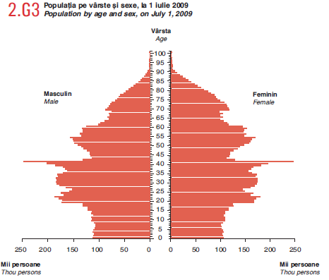
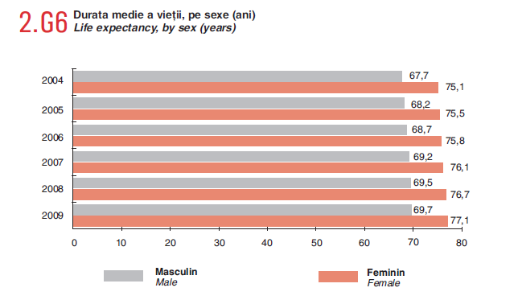
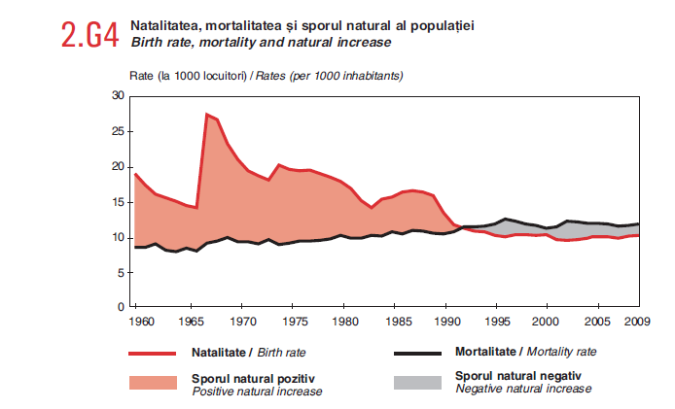
Romania population’ statistics
back

Slide 8
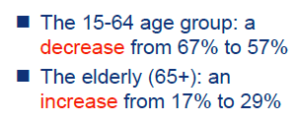
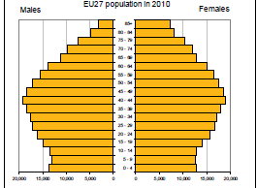
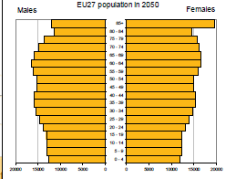
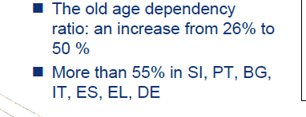
EUROSTAT - projections
Source: Eurostat
back
Notes:
Just looking on graphs, the shape of the pyramid is dramatically changing in less than 40 years.

Slide 9
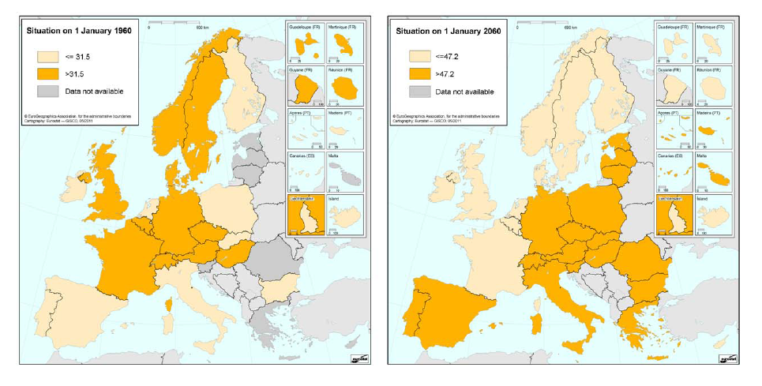
Countries above and below the average of the median age – in selected years
Notes:
Please pay attention on how the colors were changed …illustrating the increase of the average of median age in the past, present and future years…

Slide 10
Topic 1 Defining the problem (2)
c) The long-run implications of population ageing in term of policies
The effects on the ability of population to work= later retirement = a realistic policy and an available individual choice
The change in people’s mentality about work & leisure ( today , the retirement years are seen as leisure time)
The visible changes in economic behaviour during the working years – save more spend less
A financial literacy is needed , we should be able to raise awareness among current young & adult working generations – proactive approach

Slide 11
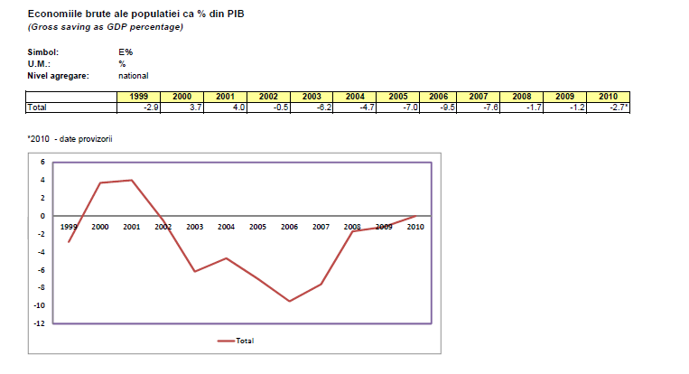
Save less…spend more (Romanians & savings)
Back 1
Back 2

Slide 12
Topic 2 Four basics approaches to the population ageing
Workers save more and consume less in order to prepare better for their retirements.
Evidences – statistics of savings and trend consumption
2. Workers pay higher taxes ( and consume less) in order to finance benefits for older people
Social turbulences - people are not accepting easily the increasing of taxation – big
A reform of social benefit system is required in many EU countries – Romania case
In our consumption society , producers/ sellers are encouraging consumption through intensive marketing campaigns - a lesson to learn …how to educate people in this case to voluntarily reduce their consumption? Is it possible?
3. Benefits ( and thus consumption) for older people are reduced so as to bring them in line with current tax and saving rates.
Reducing benefits - a decisional options, need structural reforms of social protection national systems
4. People work longer and retire later, raising their earnings and national outputs.

Slide 13
Topic 3. People’s economic behaviour during their life cycle (1)
Behaviour‘ determinants :
Factors affecting income security in old age (aggregate demand, savings and investments) -
- the society ‘s burden in transfer flows through all public and private channels
The capability for governments to maintain the current levels of publicly funded support for old people
b) Investigate trends in private pension provisions
What levels of personal savings would be necessary in order for people to sustain their living standards in retirement ?
Our options are few : consume less, work more or both! Are we prepare to accept it?
Romanians are not…
Notes:
There are various assumptions about retirement age , health care costs growth, public support for older persons, the effects of increased national savings on investment returns.

Slide 14
Topic 3. People’s economic behaviour during their life cycle (2)
Higher saving rates for working population will reduce their current consumption!!!!
- Age patterns of consumption have been changed
- Raising payroll taxes would reduce consumption and it making possible to pay more benefits for current and future elderly population
Basically the fundamental issue that society faces is how to allocate the increased costs of population ageing across these sources
Each option= different implications
It’s time to act any delay will be a heavy “legacy liability” that will be passed to future generations.
Social effects: impacts on families, households structure, redesign the transportation or built environment
Notes:
Age patterns of consumption have been changed , particularly if we include health care. In 1960 consumption in age of 60 was lower that at the younger adult ages. In 2007, evidences are showing that the age-consumption profile has been transformed radically. The elderly consume substantially more than younger people. The combination of declining labor earnings at older ages with sharply increasing consumption means that population ageing has become more costly, both for individuals and for society as a whole.
An other important issue that should be considered is how population ageing might affect total holdings of wealth, the composition of assets such as : houses, consumer durables, or corporate capital. Basically the economic theory suggests that many households accumulate savings for precautionary reasons and for retirement. Romania?
Analyses on demographic ageing are often focused on tangible and financial wealth, some times the impact of human capital is rarely considered. Human capital refers to the useful skills of the population acquired through formal and informal education, training, on-the-job experience. Relevant recent studies indicate that human capital is just important as tangible capital as a driver of economic growth. Investing in education – is a real option (higher education is associated with longer life) better health…education improves also the financial literacy.
There is little research on the impact of ageing on investment in human capital. The most human capital was accumulated in the early stages of the life cycle. Today were are talking about “smart growth” through life long learning .

Slide 15
Topic 4 The policy-makers of today and their legacy to pass on future generations
- The economic prospects in the coming years
-The sources of economic growth: productivity, innovation, creativity
The generation and distribution of new scientific, technological knowledge as gains in efficiency.
The need for actions should be seen as a today decision no a later one. Economic crisis in EU 27 is telling to policy- makers that urgent decisions are more than welcome.
- Fiscal policy – many state budgets are imbalanced or the equilibrium between revenue and spending is rather fragile.
Notes:
The productivity will increase due to higher inputs : increases in the quantity and quality of private & public capital, improved education, training and skill of the labor force.
Current global trends are witness that having a younger population will help drive invention and innovation, based on the fact that young people are more creative. As the population ages so does the labour force. An aged labour force is considered less productive, no deep research was undertook on this direction so far in Romania, nor in EU.
The description of the consequences of population ageing is based on forecasts, but any forecast is subject to uncertainty and uncertainty means that action should be accelerated rather than delayed. Adaptive mechanism are needed.

Slide 16
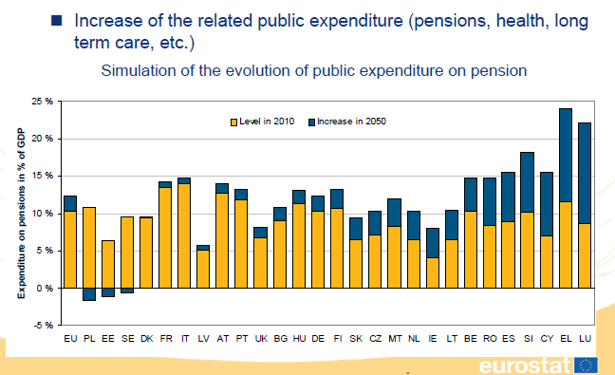
Population ageing – fiscal impact
back

Slide 17
5. Further research - suggestions
4 main area:
Demographic and health measurement and projections
Evaluate the capacity to work longer
Changes in consumption and savings through a better communication ….to achieve this desired social behaviour
modeling the efforts of decision-makers, and build reliable data on the structural changes in revenue and spending
Thank you!
Notes:
It became clear that there are many topics for which more knowledge would help the decision –making process.

